Slide 1
Effect of La Nina/El Nino on Boulder Snowfall
Jack Rice

Slide 2
Introduction
Boulder, CO and most of the front range is facing its latest first measurable snowfall in recorded history
We are entering a Weak to Medium La Nina like the 2016/17 and 2020/21 winter season
La Nina patterns drastically change when and where snow falls
The 2019/20 winter season did not face a La Nina or El Nino so we can use this as a baseline
Objective: Determine the normalcy of a lack of snowfall in the 2021/22 winter season and what role La Nina is playing in this

Slide 3
Method
Use current Temperature/Snowfall data from this year (2021) in October - End of November
Compare the ONI (Oceanic Nino Index) 3.4 region to previous years
Use the Temperature/Snowfall data from 2016/17 and 2020/21 (similar La Nina patterns) to compare to this season
Utilize the same data from the 2019/2020 season as an average year baseline without La Nina/El Nino effects
All data used is from the NOAA Climate Data Online Database

Slide 4
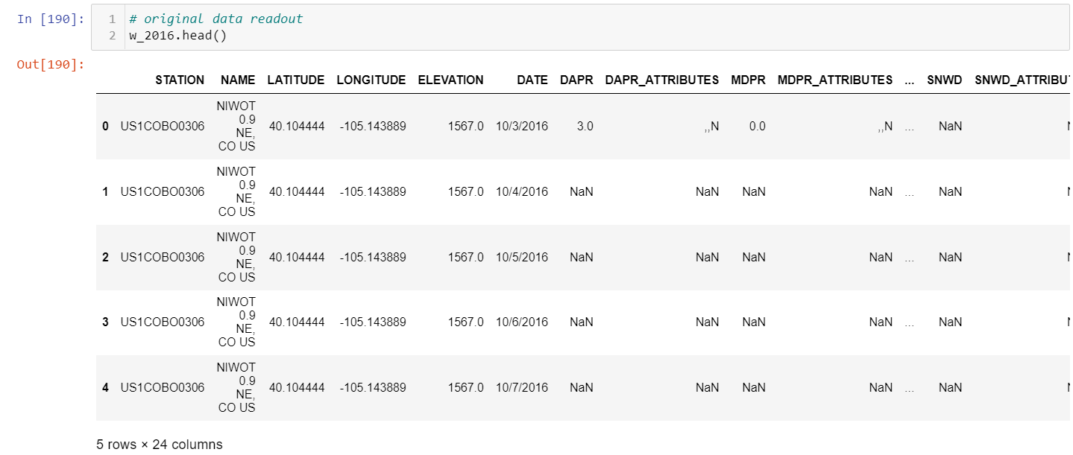
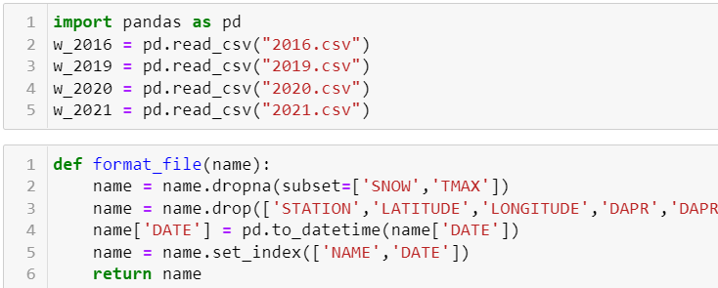
Method
Python utilization
Primarily using Pandas and Matplotlib Pyplot
Read in CSV files and format them to include only the data necessary

Slide 5
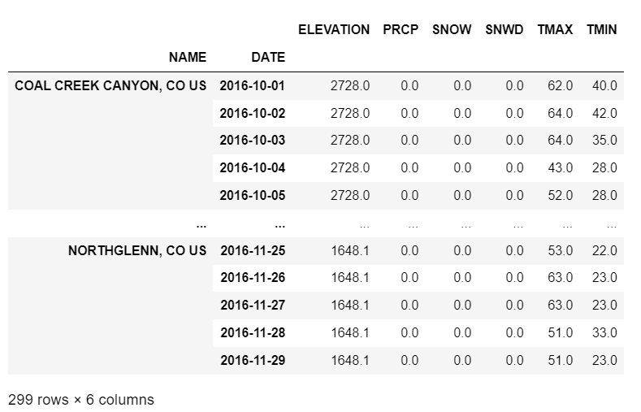
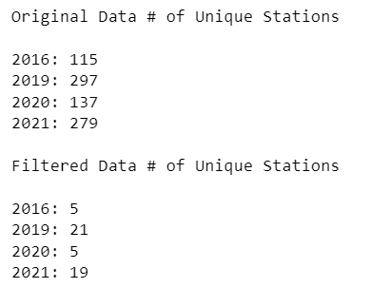
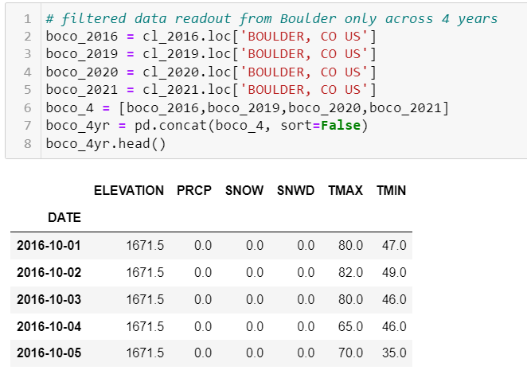
Method
The original data included multiple weather stations which don’t all contain the correct information (such as snowfall or temperature)
Boulder, CO is the primary station of focus
To compare over the 4 years, all DataFrames were combined
Each year's data spans the exact same month/day window (Oct 1 to Nov 29)
Filtered all stations to Boulder, CO station

Slide 6
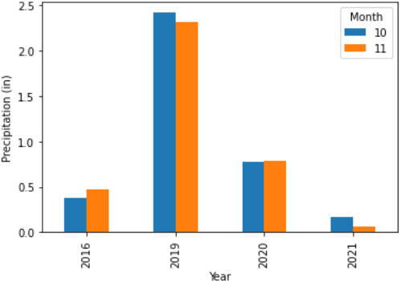
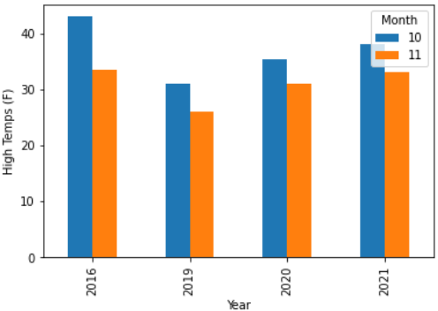
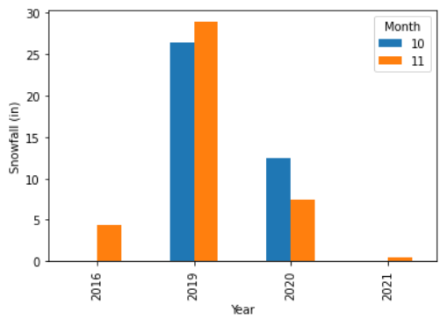
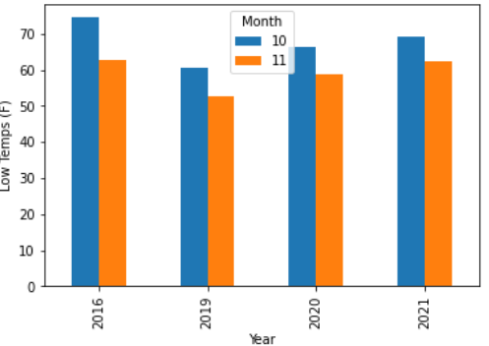
Results
-0.7
0.4
-1.2
-0.8
-0.7
0.4
-1.2
-0.8
2019 Winter without La Nina or El Nino started with higher snowfall and lower temps
2020 had an earlier, more powerful La Nina. Snowfall and temps are closer to “normal” but still low early season
2016 and this year (2021) experienced very similar figures across the board. La Nina strengths are nearly identical in these years
Precipitation Monthly Totals
High Temp Avgs
-0.7
0.4
-1.2
-0.8
-0.7
0.4
-1.2
-0.8
Snowfall Monthly Totals
Low Temp Avgs

Slide 7
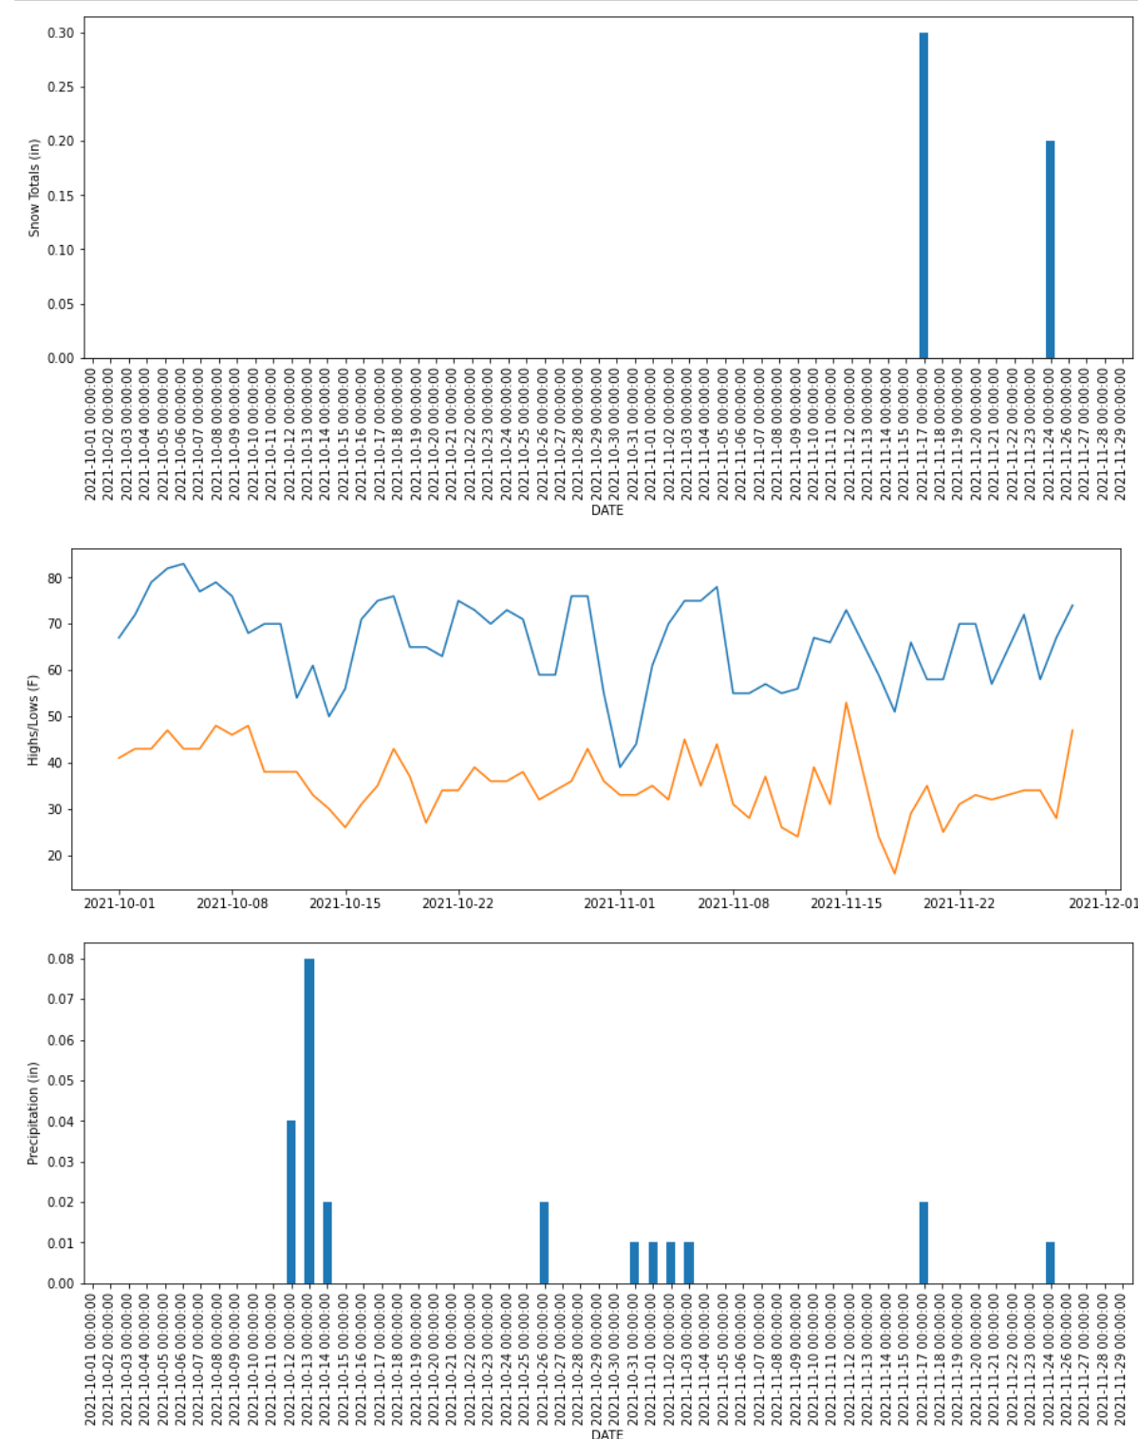
Results
2016’s Oct-Nov, similarly to 2021, experienced:
later than normal snowfall
low precipitation
higher than average temperatures

Slide 8
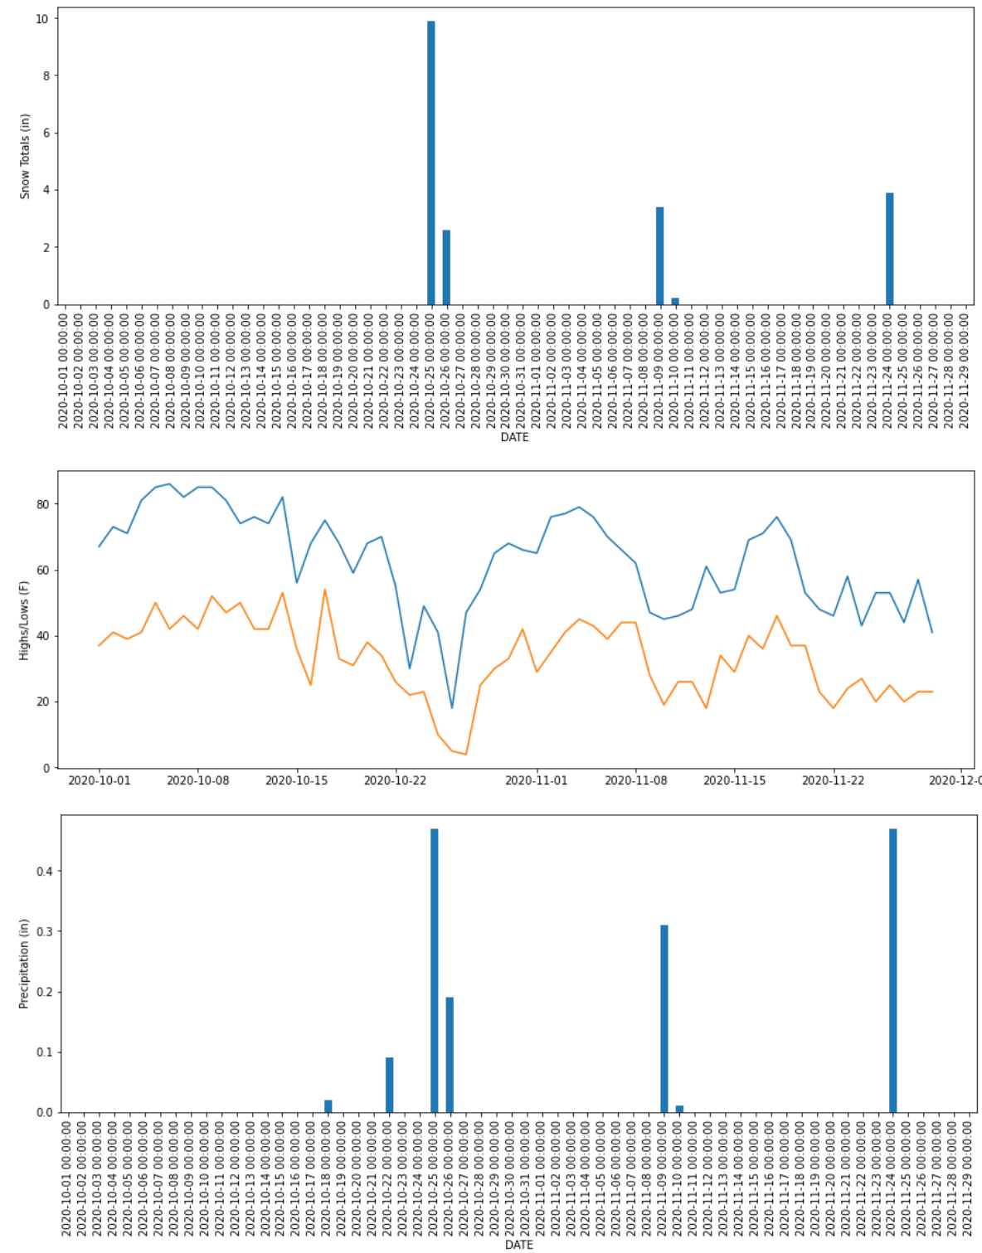
Results
2020’s normal year experienced:
A powerful storm in late October
Higher than average temps but more fluidity in temperature
More potent and fewer storms rather than consistent precipitation (as seen in 2016 and 2021)

Slide 9
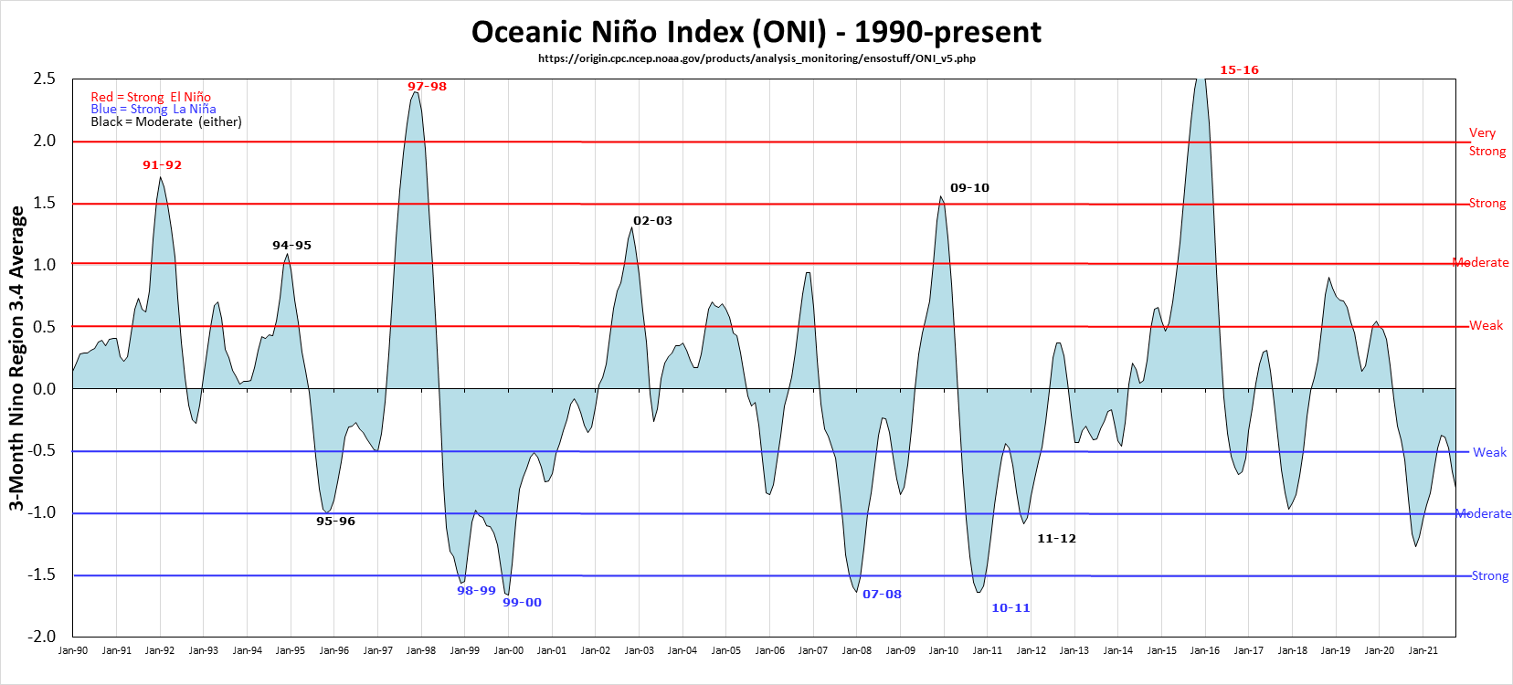
Results

Slide 10
Conclusion
Weaker La Nina patterns exhibit less potent early season snowfall
Concurrent La Nina years often exhibit weaker patterns than the year prior
More potent storms generally appear later in the winter season in La Nina years
Despite ONI values being very similar to 2016, this season is experiencing much less precipitation than all 4 previous years studied
Limitations: La Nina and El Nino play a large role in snowfall and temperatures but are not the only factors. This analysis only factored in ONI values in relation to snowfall, but didn’t account for different factors such as jetstream variances or climate changes

